Slide 1
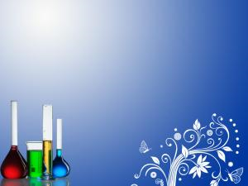
P Block Elements
Elements in which the last electron enters the p-subshell of their outermost energy level are called p-block elements. The elements belonging to groups 13 to 18 constitute p-block elements.

Slide 2
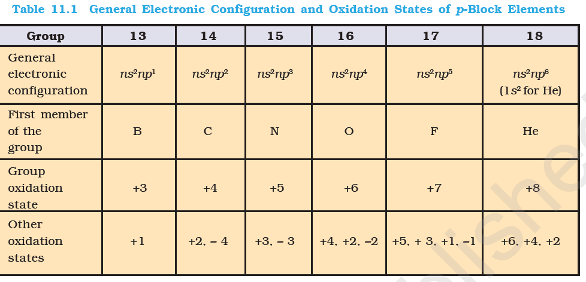
General electronic configuration for elements belonging to p-block is ns2np1-6
General characteristics of p-block elements
Variation in oxidation states:

Slide 3
The first member of p-block differs from the
remaining members of their corresponding group in two major respects. It is due very small size of first element and absence of d orbitals.
boron forms only [BF4]– while aluminium gives [AlF6]3– ion. It is due to the reason that because of the presence of vacant d orbital Al can extend its covalancy whereas boron cannot.

Slide 4
The first member of a group differs from the heavier members in its ability to form pπ - pπ multiple bonds to itself and to other second row elements.
The heavier elements do form π bonds but this involves d orbitals (dπ – pπ or dπ –dπ ). As the d orbitals are of higher energy than the p orbitals, they contribute less to the overall stability of molecules than does pπ - pπ bonding of the second row elements.

Slide 5
Group 13 elements
Electronic Configurations: Elements of group 13 have the general outer electronic configuration of ns²np1
Elements Symbol Atomic No. Elect Conf
Boron B 5 [He] 2s²2p1
Aluminium Al 13 [Ne] 3s² 3p1
Gallium Ga 31 [Ar] 3d104s² 4p1
Indium In 49 [Kr] 4d105s² 5p1
Thallium Tl 81 [Xe] 4f145d10 6s² 6p1

Slide 6
Atomic radii: Down the group size increases. But the size of Ga is smaller than Al. It is due to the presence of additional 10 d-electrons offer only poor screening effect for the outer electrons from the increased nuclear charge in gallium.
Ionization enthalpy
Electronegativity: It first decreases from B to Al and then decreases due to discrepancies in atomic size.

Slide 7
CHEMICAL PROPERTIES
Oxidation State and trends in reactivity: Group 13 elements show +1 and +3 oxidation state but the stability of +1 oxidation state increases down the group due to inert pair effect. The reluctance of s electrons to participate in chemical bonding due to poor shielding effect of f and d electrons is called as inert pair effect.
Compounds in +1 oxidation state are more ionic as compared in +3 oxidation state.

Slide 8
In trivalent state the compounds of these compounds are electron deficient and act as Lewis Acids.
The tendency to behave as Lewis acid decreases with the increase in the size down the group.
Reactivity towards air: Group 13 elements combine with oxygen to form oxides with general formula M2O3. Boron trioxide is acidic and reacts with basic (metallic) oxides forming metal borates. Aluminium and gallium oxides are amphoteric and those of indium and thallium are basic in their properties.

Slide 9
Reactivity towards acids and alkalies
Boron does not react with acids as well as alkalies but Al reacts with both acids as well as alkalies that is why it is amphoteric in nature.
Reactivity towards Halogens: These elements combine with halogens to form trihalides EX3.

Slide 10
Important compounds of boron
Borax: Na₂B₄O₇⋅10H₂O
Borax dissolves in water to give an alkaline solution.
Na2B4O7 + 7H2O → 2 NaOH + 4H3BO3
On heating, borax first loses water molecules and swells up. On further heating it turns into a transparent liquid, which solidifies into glass like material known as borax bead.

Slide 11
The metaborates of many transition metals
have characteristic colours and, therefore, borax bead test can be used to identify them in the laboratory.
Orthoboric acid: (H₃BO₃)
It can be prepared by acidifying an aqueous solution of borax.
Na₂B₄O₇ + 2HCl + 5H₂O → 2NaCl + 4B(OH)₃
Boric acid is a weak monobasic acid. It is not a protonic acid but acts as a Lewis acid by accepting electrons from a hydroxyl ion:
B(OH)₃ + 2H2O → [B(OH)₄]– + H₃O⁺

Slide 12
On heating, orthoboric acid above 370K forms metaboric acid, HBO2 which on further heating yields boric oxide, B2O3.
H₃BO₃ ⎯Δ→ HBO₂ ⎯Δ→ B₂O₃

Slide 13
Boranes
The simplest boron hydride known,is diborane. It is prepared by treating boron
trifluoride with LiAlH4 in diethyl ether.
4BF₃ +3LiAlH₄ → 2B₂H₆ + 3LiF + 3AlF₃
Diborane catches fire spontaneously upon exposure to air. It burns in oxygen releasing an enormous amount of energy.
B₂H₆ +3O₂ → B₂O₃ + 3H₂O

Slide 14
Boranes are readily hydrolysed by water to give boric acid.
B₂H₆(g) + 6H₂O(l) → 2B(OH)₃(aq) + 6H₂(g)
Reaction of ammonia with diborane gives
initially B₂H₆.2NH₃ which is formulated as
[BH₂(NH₃)₂]+ [BH₄]– ; further heating gives
borazine, B₃N₃H₆ known as “inorganic Benzene”

Slide 15
Structure of diboranes
In diborane Boron undergoes sp3 hybridization. One of the four hybrid orbitals is vacant (shown by dotted line). Two of the sp3 hybrid orbitals form sigma bond with 1s orbitals of H atoms. The hybrid orbital containing unpaired electron overlap simultaneously with 1s orbital of H atom and vacant hybrid orbital of the adjacent boron atom to form three centre electron pair bond. This is also called as Banana bond.

Slide 16
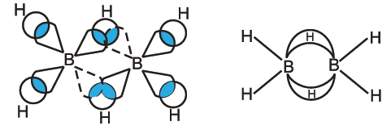

Slide 17
GROUP 14 ELEMENTS
General electronic configuration: ns² np²
Atomic radii increases down the group.
Ionization enthalpy: First ionization enthalpy of 14 group element is more than 13 group elements.
Electronegativity: These are more electronegative than 13 group elements.

Slide 18
Chemical properties of 14 group elements
Oxidation states and trends in chemical reactivity: Group 14 elements show +2 and +4 oxidation states. Down the group stability of +2 oxidation states increases due to inert effect.
carbon cannot exceed its covalence more than
4, other elements of the group can do so. It is
because of the presence of d orbital in them.

Slide 19
CCl4 cannot be hydrolyzed but SiCl4 can be hydrolysed because of the presence of vacant d-orbitals in carbon. Due to this carbon cannot extend its covalency beyond 4 but Si can do.
Reactivity towards air: these elements combine with oxygen to give oxides with general formula EO or EO2. eg CO and CO2.
The dioxides — CO2, SiO2 and GeO2 are acidic, whereas SnO2 and PbO2 are amphoteric in nature. Among monoxides, CO is neutral, GeO is
distinctly acidic whereas SnO and PbO are amphoteric.

Slide 20
Reactivity towards halogens: These elements form halides with general formula EX2 and EX4. Most of the EX4 are covalent in nature and undergo sp3 hybridization.
Stability of dihalides increases down the group. Considering the thermal and chemical stability, GeX4 is more stable than GeX2,
whereas PbX2 is more than PbX4.

Slide 21
Anomalous behaviour of carbon
It is due to its smaller size, higher electronegativity, higher ionisation enthalpy and unavailability of d orbitals.
Carbon also has unique ability to form pπ– pπ multiple bonds with itself and with other atoms of small size and high electronegativity.
Few examples of multiple bonding are: C=C,
C ≡ C, C = O, C = S, and C ≡ N.

Slide 22
Carbon atoms have the tendency to link with one another through covalent bonds to form chains and rings. This property is called catenation. This is because C—C bonds are very strong. Down the group the size increases and electronegativity decreases, and, thereby, tendency to show catenation decreases.
ALLOTROPES OF CARBON:
(1) Diamond: In diamond each carbon atom undergoes sp3 hybridisation and linked to four other carbon atoms by using hybridised orbitals

Slide 23
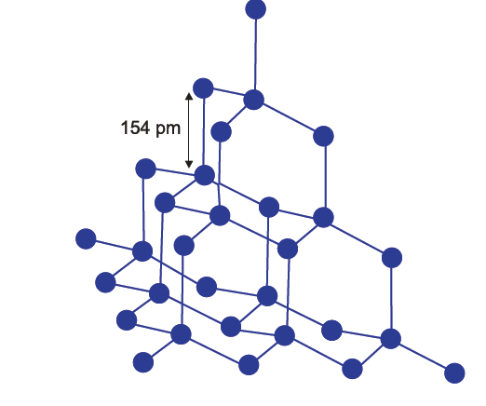

Slide 24
It is very difficult to break extended covalent
bonding and, therefore, diamond is a hardest
substance on the earth.
GRAPHITE: Each carbon atom in hexagonal ring undergoes sp2 hybridisation and makes three sigma bonds with three neighbouring carbon atoms. Fourth electron forms a π bond. The electrons are delocalised over the whole sheet. Electrons are mobile and, therefore, graphite conducts electricity along
the sheet.

Slide 25
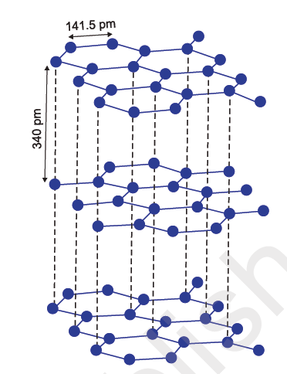
it is very soft and slippery. For this reason graphite is used as a dry lubricant in machines

Slide 26
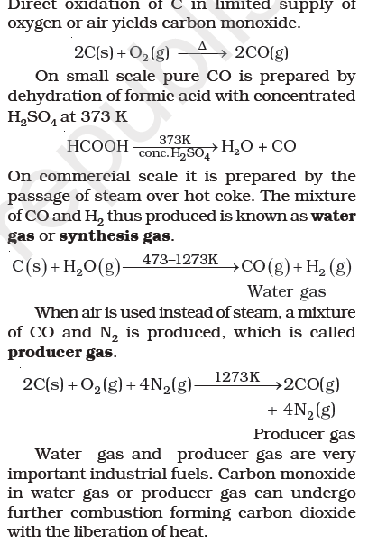
Important compounds of carbon and silicon
Carbon monoxide

Slide 27
The highly poisonous nature of CO arises because of its ability to form a complex with haemoglobin, which is about 300 times more stable than the oxygen-haemoglobin complex. This prevents haemoglobin in the red blood corpuscles from carrying oxygen round the body and ultimately resulting in death.
Carbon Dioxide: It is prepared by complete combustion of carbon.
C(s)+ O2(g)→ CO2(g)
CH4(g)+ 2O2(g) → CO2(g) +2H2O(g)

Slide 28
Commercially it is obtained by heating CaCO3.
Photosynthesis. It is the process by which green plants convert atmospheric CO2 into carbohydrates such as glucose.
But the increase in combustion of fossil fuels and decomposition of limestone for cement manufactur in recent years seem to increase the CO2 content of the atmosphere. This may lead to increase in green house effect and thus, raise the temperature of the atmosphere which might have serious consequences.

Slide 29
Carbon dioxide can be obtained as a solid in the form of dry ice
Silicon Dioxide, SiO2: Silicon dioxide, commonly known as silica, occurs in several crystallographic forms. Quartz, cristobalite and tridymite are some of the crystalline forms of silica.
Silicon dioxide is a covalent, three dimensional. network solid in which each silicon atom is covalently bonded in a tetrahedral manner to four oxygen atoms.

Slide 30
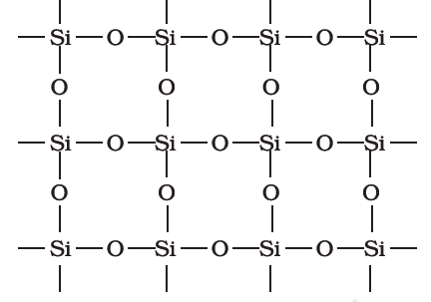

Slide 31
Silicones
They are organosilicon polymers, which have (R2SiO) as a repeating unit. When methyl chloride reacts with silicon in the presence of copper as a catalyst at a temperature 573K various types of methyl substituted chlorosilane of formula MeSiCl3, Me2SiCl2, Me3SiCl with small amount of Me4Si are formed. Hydrolysis of dimethyldichlorosilane, (CH3)2SiCl2 followed by
condensation polymerisation yields straight chain polymers.

Slide 32
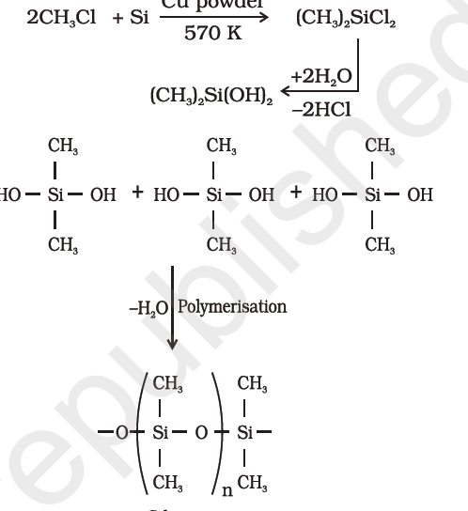

Slide 33
Silicates
The basic structural unit of silicates is SiO₄⁴⁻ in which silicon atom is bonded to four oxygen atoms in tetrahedron fashion. In silicates either the discrete unit is present or a number of such units are joined together via corners by sharing 1,2,3,4 atoms per silicate units. When silicate units are linked together they form chains, ring and three dimensional structures.

Slide 34
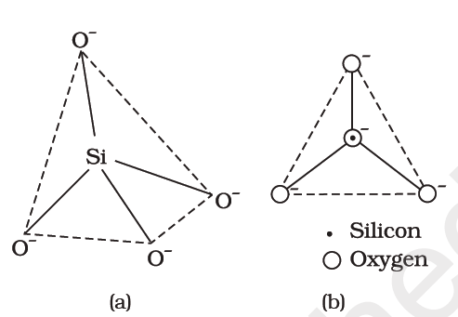

Slide 35
Zeolites

Slide 36
THANK YOU

